Slide 1
Speaker Diarization with LSTM
Authors: Quan Wang, Carlton Downey, Li Wan,
Philip A. Mansfield, Ignacio Lopez Moreno
Presented by: Quan Wang
Notes:
Paper: https://arxiv.org/abs/1710.10467

Slide 2
Part 1:
Introduction

Slide 3
What is speaker diarization?
The process of partitioning an input audio stream into homogeneous segments according to the speaker identity
“Who Spoke When?”
Speaker 1
Speaker 2

Slide 4
Why diarization?
Lots of applications:
Medical records: doctor vs. patient separation
Automatic notes-generation for meetings
Source separation
Call center data analysis

Slide 5
Hero application: Improve ASR
Speaker boundaries could help improve ASR
1st pass ASR
I would like to sort of buy needle interrupt
Diarization
I would like to sort of buy needle interrupt
Speaker1
Speaker2
Discouraged by language model in 1st pass
2nd pass ASR on homogeneous-speaker segments
I would like to … Sorry but I need to interrupt

Slide 6
What diarization is NOT?
Diarization ≠ Source separation
Diarization: We usually assume there is no overlapped speech
Diarization Error Rate (DER): Most people remove overlapped speech first
People are starting to solve diarization and source separation problems jointly

Slide 7
What diarization is NOT?
Diarization ≠ Speaker change detection
Diarization: We care about speakers previously appeared in the utterance
Speaker change detection: We only care about the “deltas”
Discovering previously appeared speaker
Output of diarization
Output of change detection

Slide 8
What diarization is NOT?
Diarization ≠ Speaker recognition
Timestamps are important: We need accurate segmentation
No enrollment: We don’t have voiceprints of any known speakers
Utterances are usually very long
Always text-independent

Slide 9
Part 2:
Background and System Overview

Slide 10
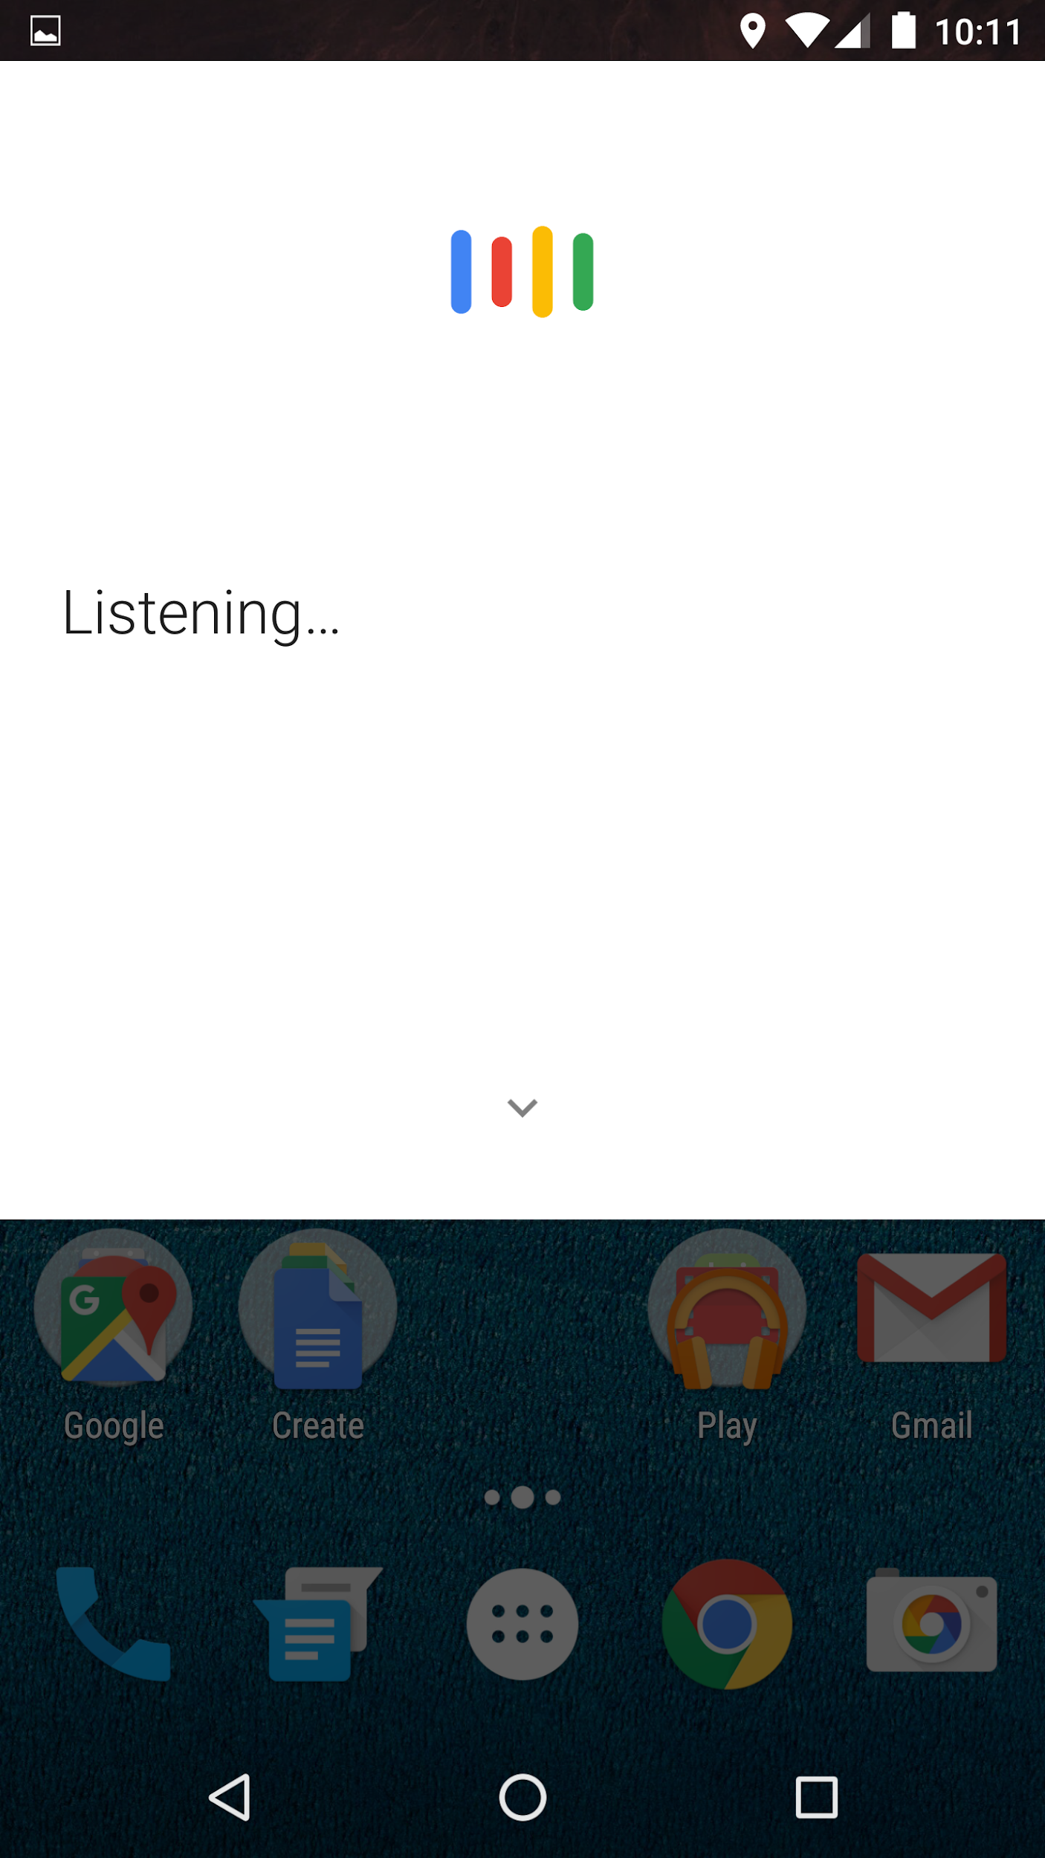
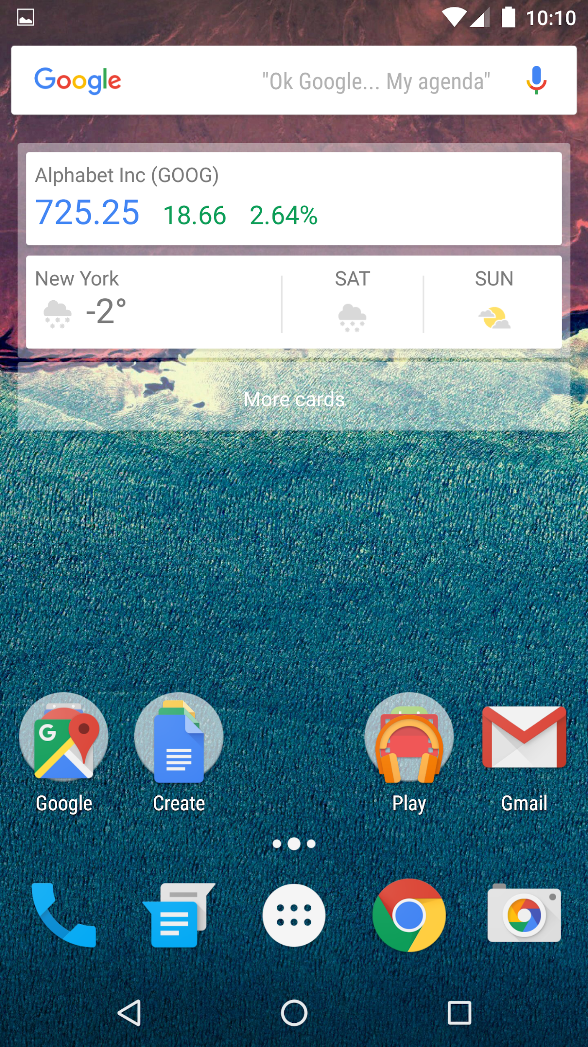
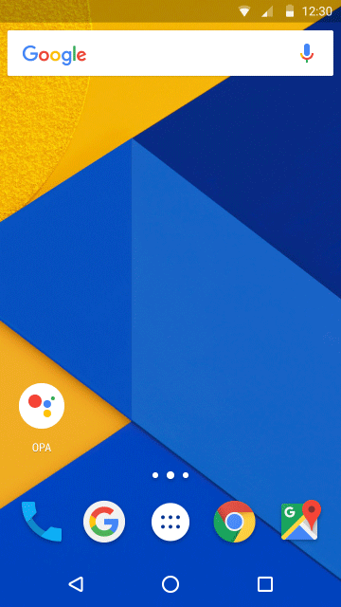

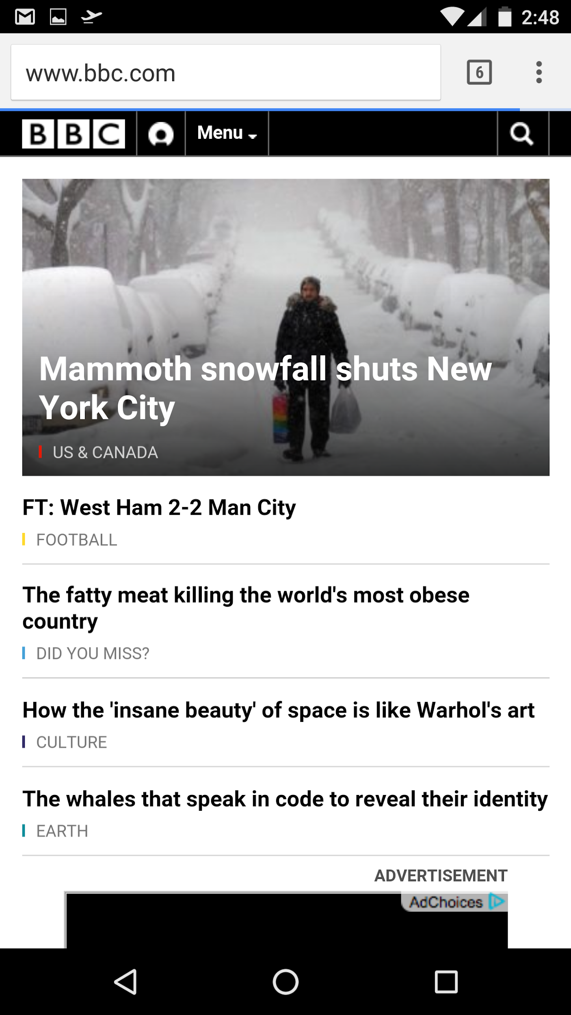
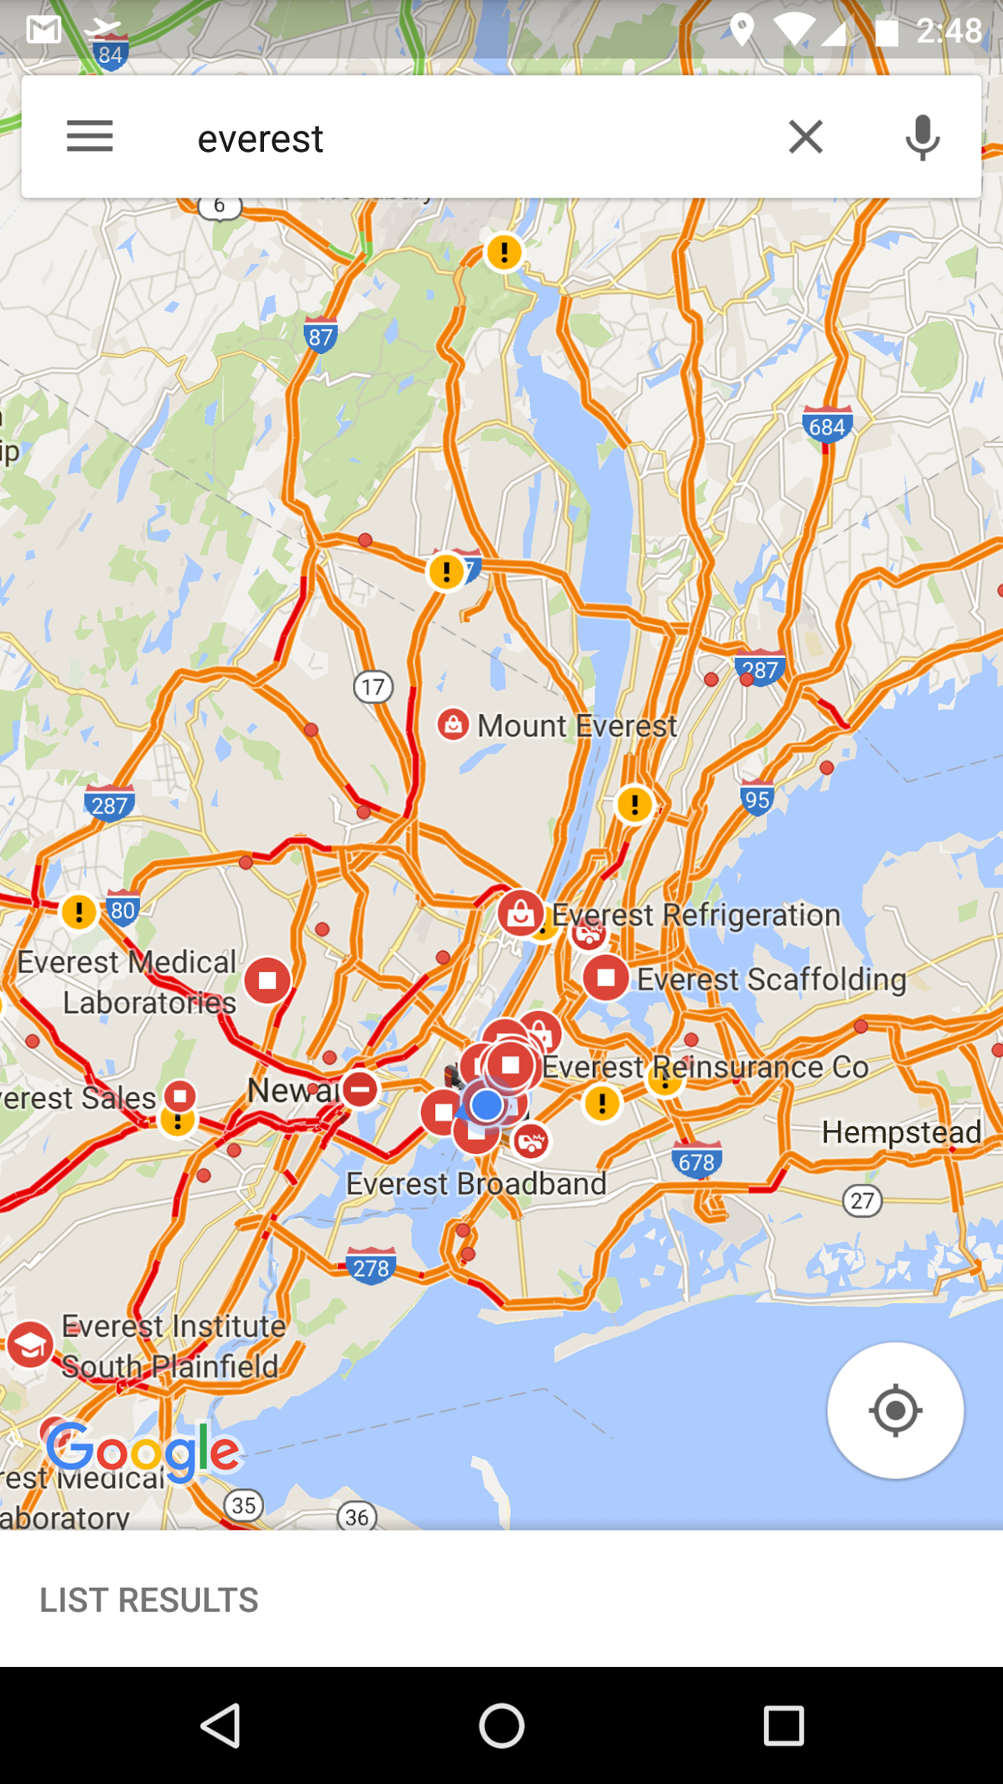
Speaker recognition at Google - Android
“OK Google”
“OK Google”
From Any Screen:
Wake the Assistant
Voice Unlock:
Free your hands
Notes:
Applications in Google products:
Waking Assistant: from news, weather, maps
Free your hands from typing passwords

Slide 11
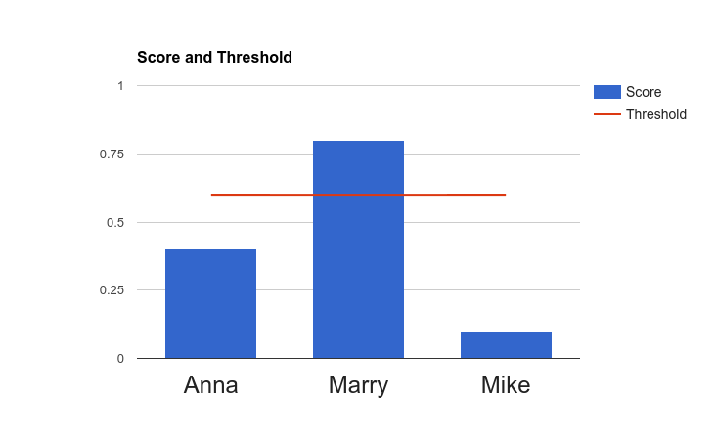
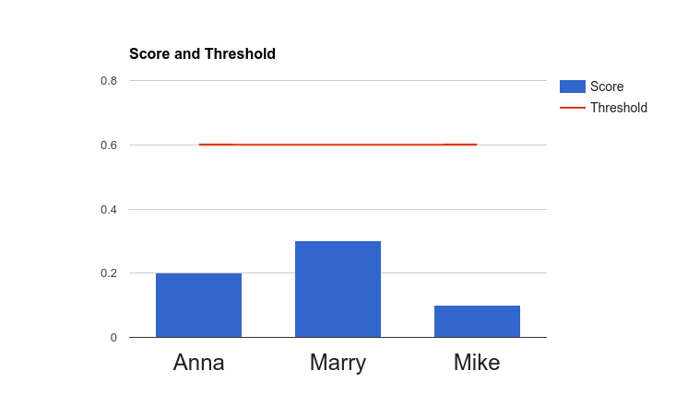


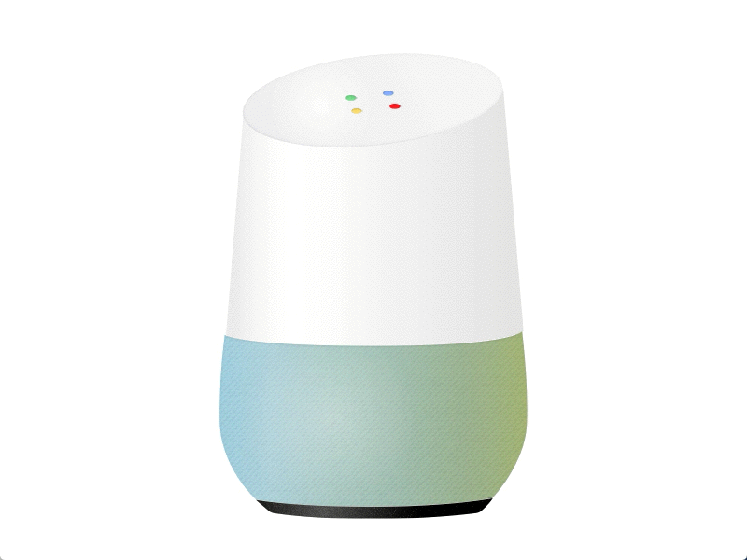


Speaker recognition at Google - Home
OK Google
Hi Andy!
OK Google
Hi Guest!
Notes:
Personalized results
Calendar
MultiUser

Slide 12
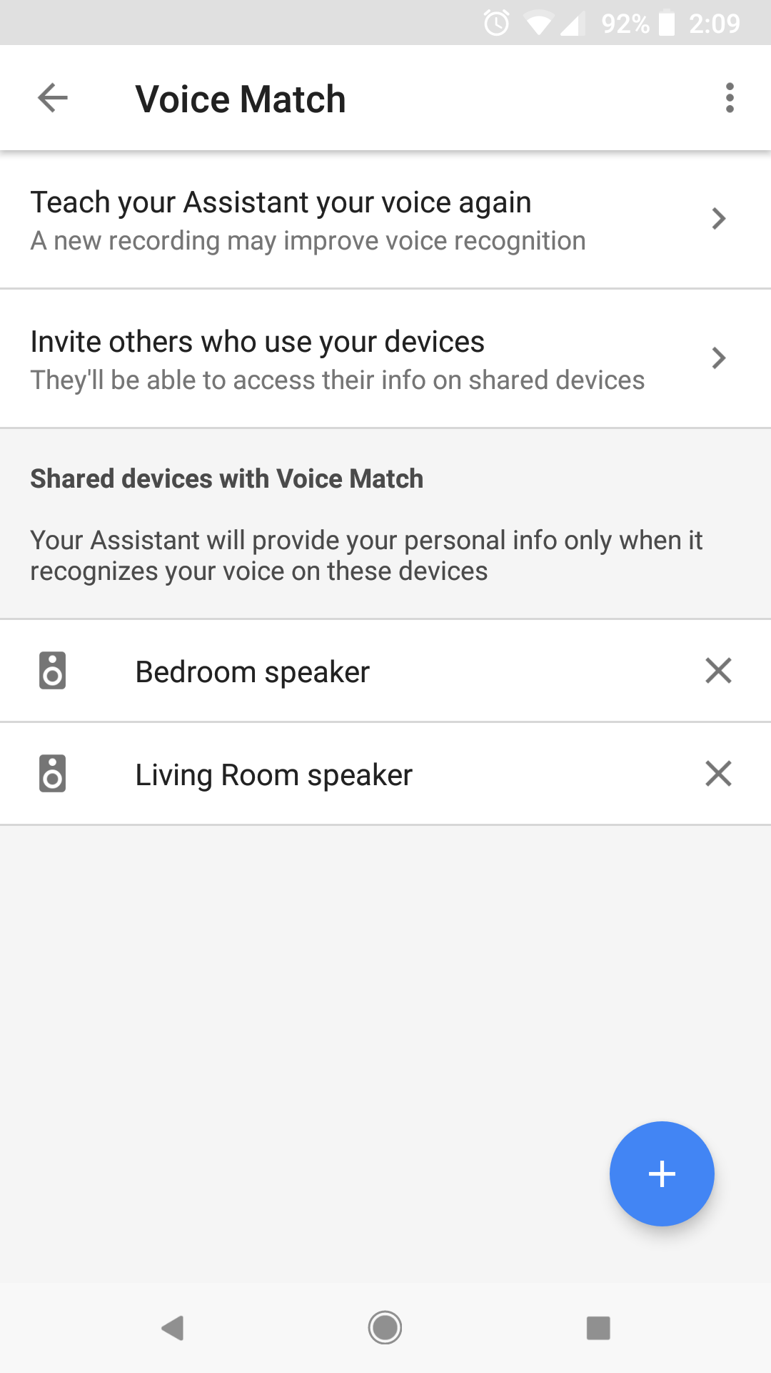
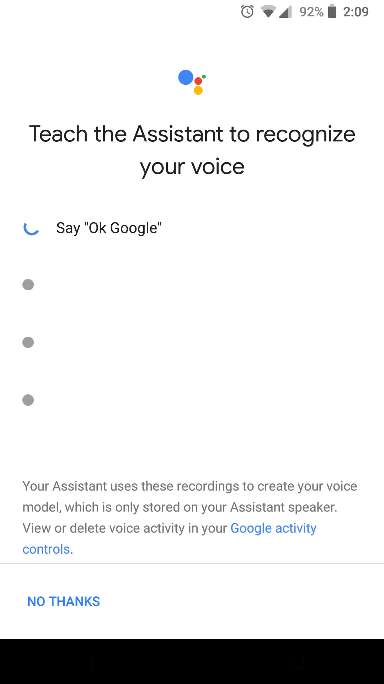
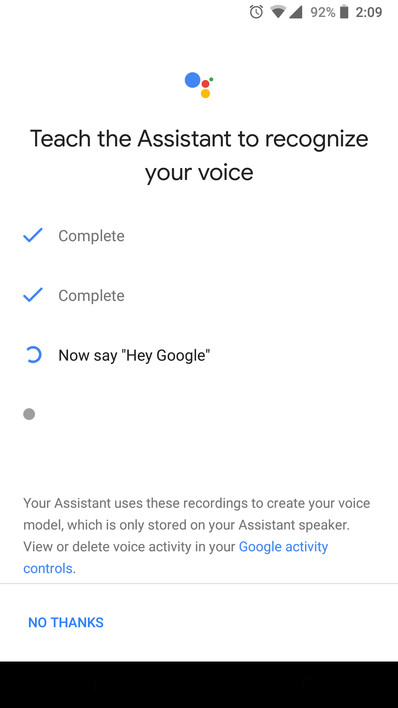
2-stage speaker recognition: Enroll and verify
Before we can verify a speaker, we need the user to enroll his voice:
Speak:
"OK Google" 2 times
"Hey Google" 2 times
Store the averaged embedding vector on device

Slide 13
Anatomy of a speaker diarization system
Speech Detection
Use Voice Activity Detector (VAD) to remove noise and non-speech
Speech Segmentation
Extract short segments, each containing a single speaker
Embedding Extraction
Generate a compact representation for each segment (i-vector, d-vector)
Clustering
Determine the number of speakers
Assign each speech segment to a single speaker
Resegmentation (optional)
Further smooth the diarization results

Slide 14
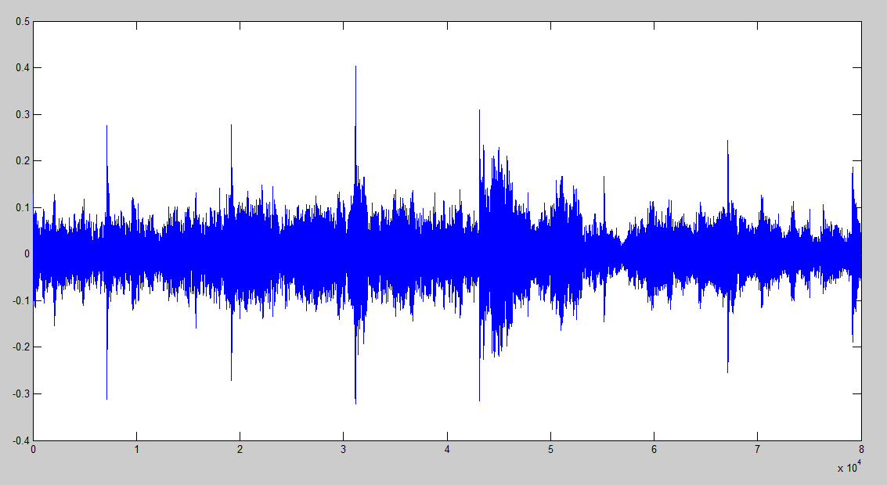
Infrastructure of our system (after VAD)
window step
Process
……
sliding windows
window size
Run LSTM
……
d-vectors
……
Aggregate
segments
……
Cluster
diarization results

Slide 15
Part 3:
Speaker Embeddings

Slide 16
From i-vectors to d-vectors
We need to extract speaker-discriminative features from audio
Utterances of same speaker: similar embeddings
Utterances of different speakers: distinct embeddings
Najim Dehak, et al.
i-vector
Georg Heigold, et al.
E2E loss
2011
2015
2016
2017
∙∙∙
Florian Schroff, et al.
Triplet loss (FaceNet)
Li Wan, et al.
GE2E loss

Slide 17
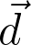
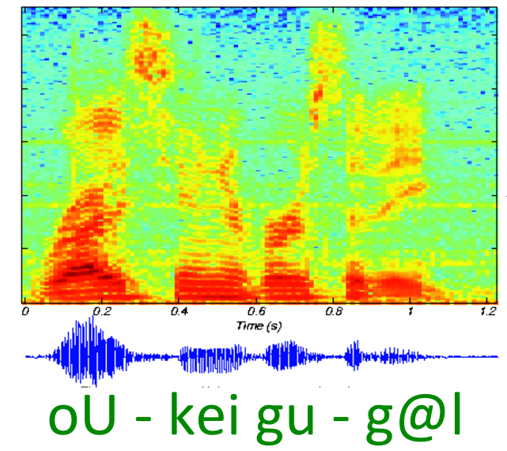
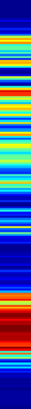
d-vector: Audio to embedding
LSTM
Cell
LSTM
Cell
LSTM
Cell
LSTM
Cell
LSTM
Cell
LSTM
Cell
LSTM
Cell
LSTM
Cell
LSTM
Cell
Fixed-length segment
Multi-layer LSTM network
D-vector

Slide 18
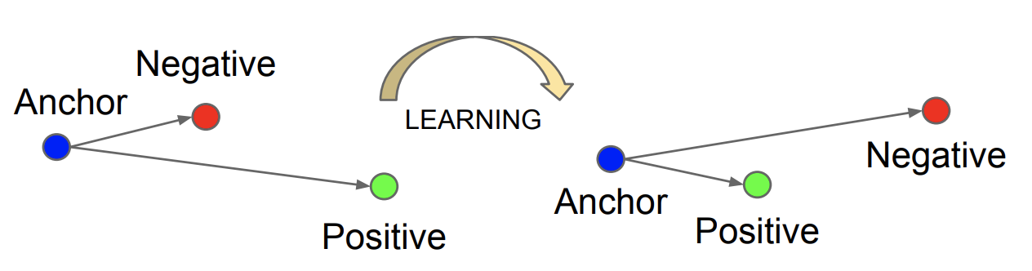
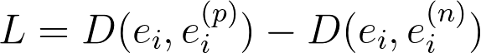
Loss function - Triplet loss
Triplet loss:
Pros: Simple, and correctly models the embedding space
Cons: Does NOT simulate runtime enrollment behavior
pair of same speaker (pos)
pair of diff speakers (neg)
Fig. Triplet loss. (image from FaceNet paper)
* Schroff, Florian, Dmitry Kalenichenko, and James Philbin. "FaceNet: A unified embedding for face recognition and clustering." Proceedings of the IEEE conference on computer vision and pattern recognition. 2015.
Notes:
L=D(e_i,e_i^{(p)})-D(e_i,e_i^{(n)})

Slide 19
Loss function - Tuple end-to-end loss
Remember the verification runtime behavior
Collect enrollment utterances
Receive verification utterance
Cosine Similarity
Average
OFFLINE
Make verification decision
Notes:
L=D(e_i,e_i^{(p)})-D(e_i,e_i^{(n)})

Slide 20
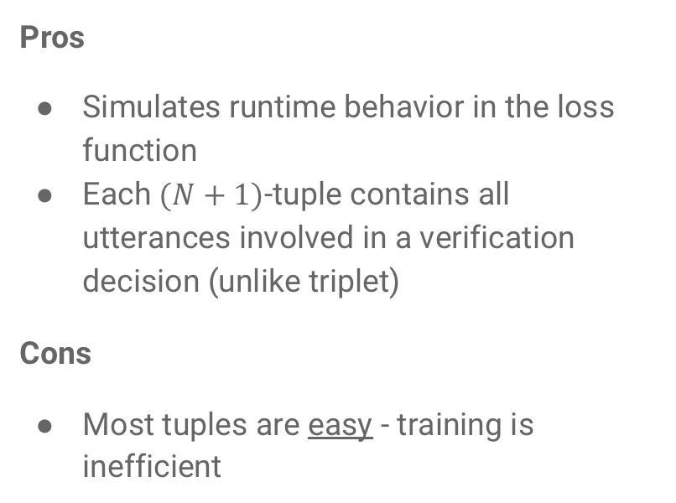
Loss function - Tuple end-to-end loss
accept / reject
Pros
Simulates runtime behavior in the loss function
Each $(N+1)$-tuple contains all utterances involved in a verification decision (unlike triplet)
Cons
Most tuples are easy - training is inefficient
logistic regression
Score Function
cosine similarity
Speaker Model
average
Speaker
Representation
...
LSTM
evaluation utterance
...
enrollment
utterance 1
enrollment
utterance N
* Heigold, Georg, et al. "End-to-end text-dependent speaker verification." Acoustics, Speech and Signal Processing (ICASSP), 2016 IEEE International Conference on. IEEE, 2016.

Slide 21
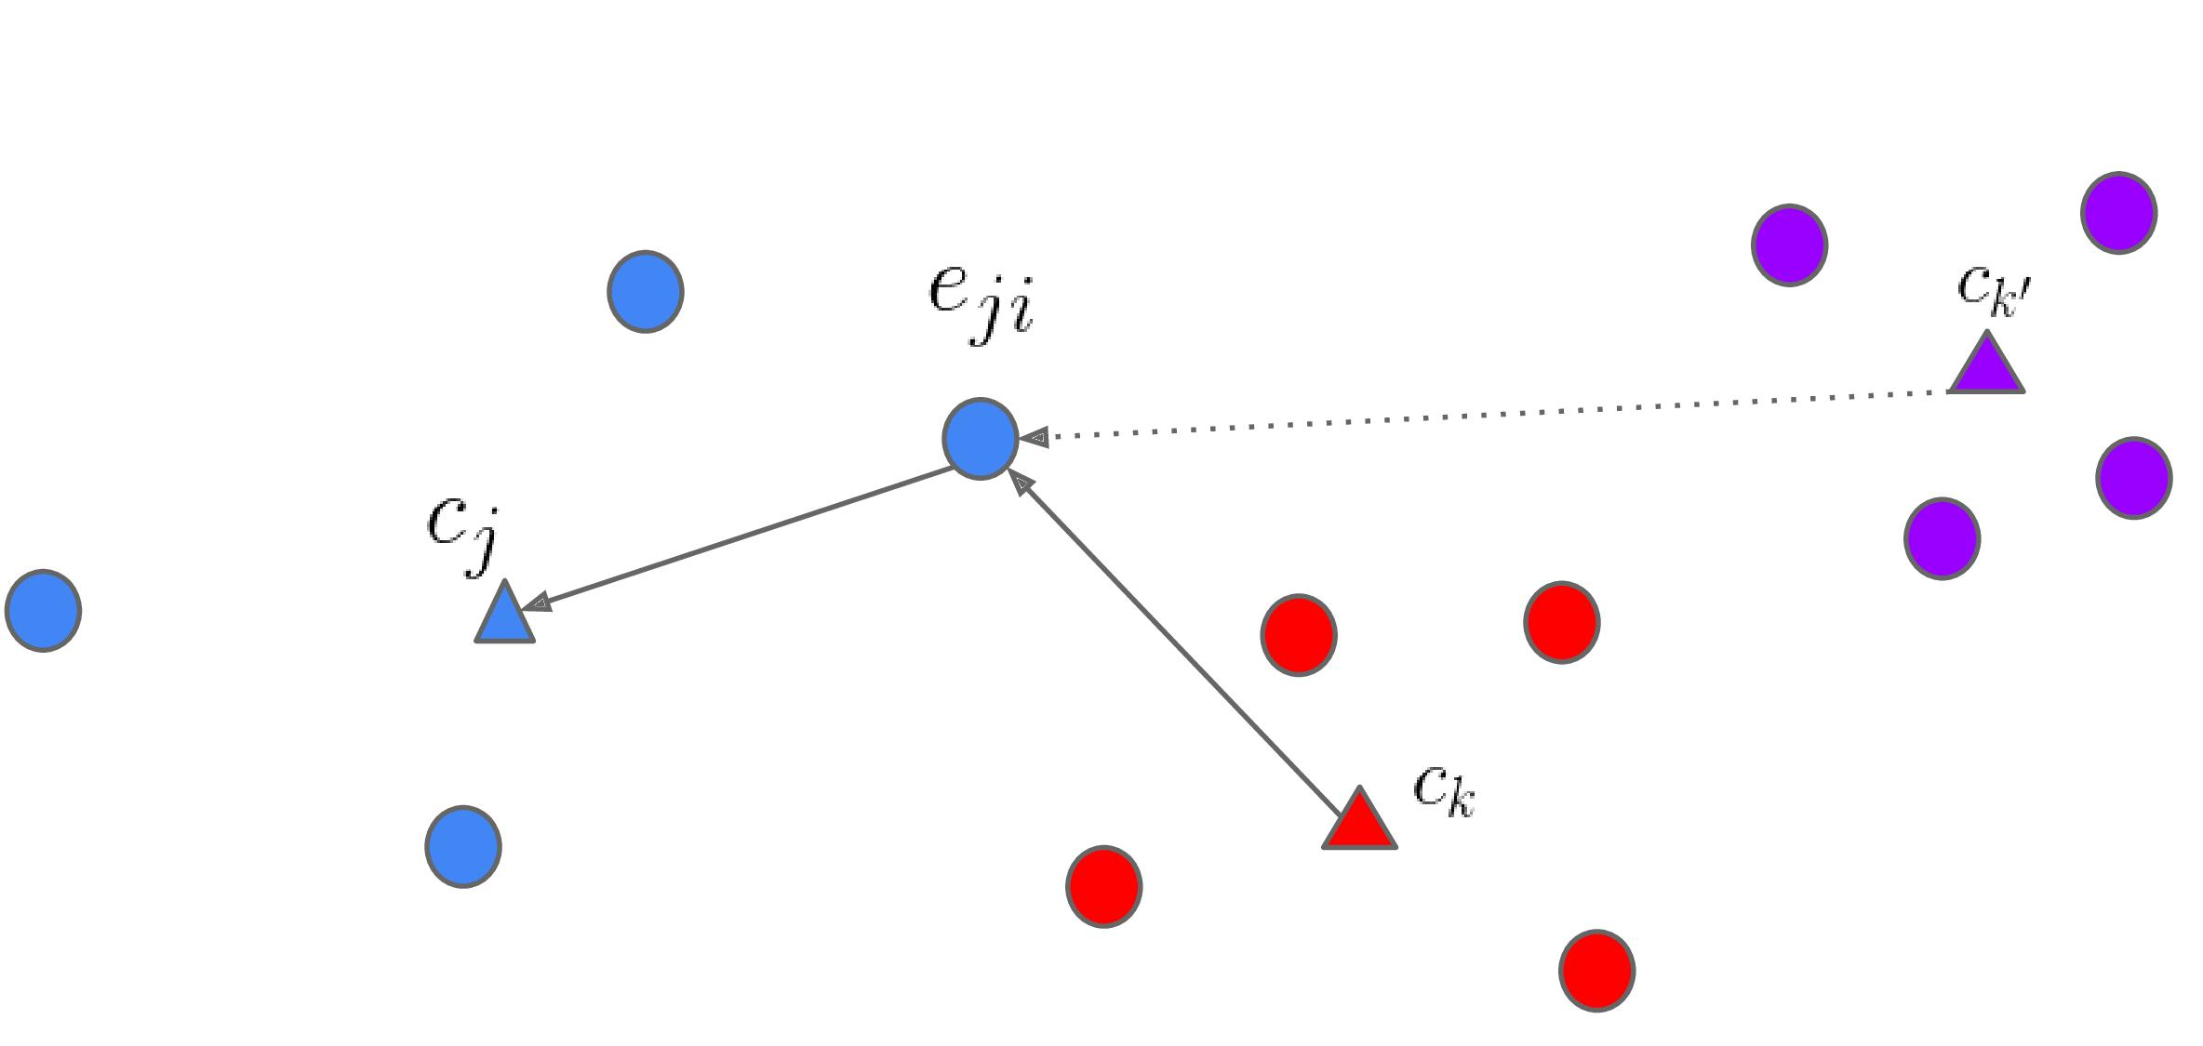
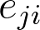
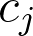
Loss function - Generalized end-to-end loss
One training batch
For each embedding , we only look at its distance to:
True speaker centroid
Closest false speaker centroid ⇒ max-margin principle, "support speaker"
Notes:
Close to true speaker centroid
Far away from closest false speaker centroid
Like support vector machine

Slide 22
Part 4:
Clustering

Slide 23
Clustering the embeddings
There are two types of clustering algorithms:
Online
Cluster label determined immediately when embedding is available
Real-time, but less accurate
Offline
Run clustering after we have received the entire utterance
More latency, better results
Post-processing: gap filling, short segment filtering, resegmentation, etc.

Slide 24
Online clustering
Naïve online
Continuously adapt or create a cluster based on thresholding
Links online
Anisotropic, probabilistic, and generative cluster modeling
Philip Andrew Mansfield, et al. "Links: A High-Dimensional Online Clustering Method." arXiv:1801.10123 (2018).

Slide 25
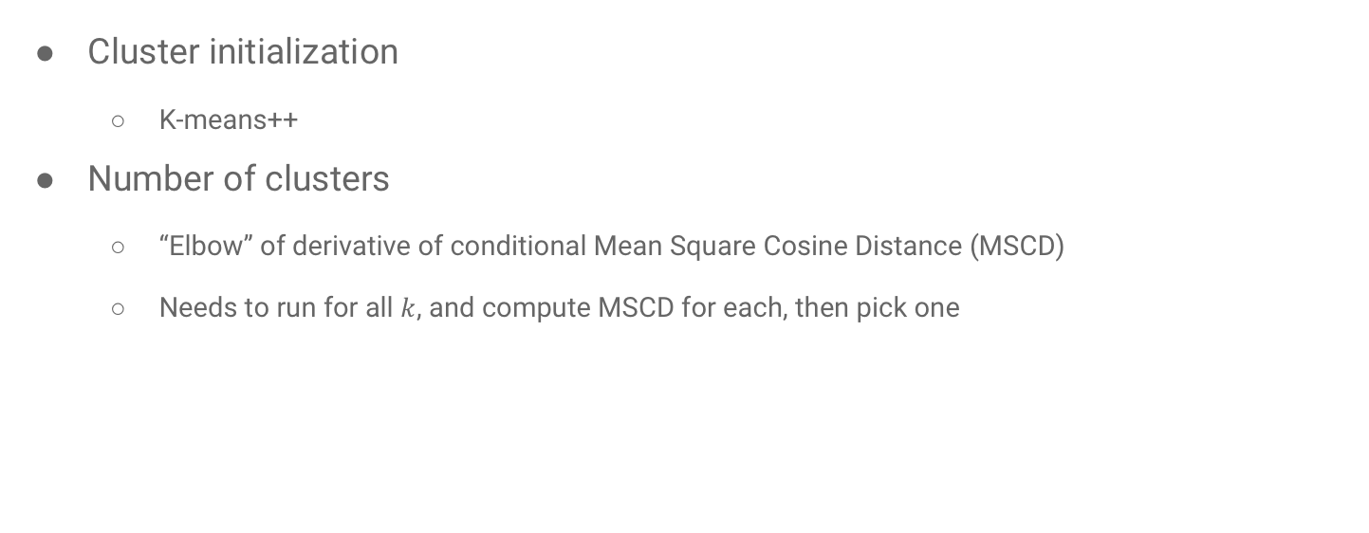
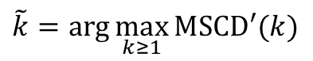
Offline clustering: K-means
Cluster initialization
K-means++
Number of clusters
“Elbow” of derivative of conditional Mean Square Cosine Distance (MSCD)
Needs to run for all $k$, and compute MSCD for each, then pick one
$$\tilde{k}=\arg{\max_{k≥1}{MSCD′(k)}}$$

Slide 26
Offline clustering: K-means
Problems:
Non-Gaussian data
Imbalanced clusters
Gender/Age/Racial effects
Overlapping speech

Slide 27
K-means: Non-Gaussian data
Speech data are often Non-Gaussian

Slide 28
K-means: Non-Gaussian data
Speech data are often Non-Gaussian

Slide 29
K-means: Imbalanced clusters
One person may speak more often

Slide 30
K-means: Imbalanced clusters
One person may speak more often

Slide 31
K-means: Gender/Age/Race effects
Inter-gender differences large, intra-gender differences small
Male
Female

Slide 32
K-means: Gender/Age/Race effects
Inter-gender differences large, intra-gender differences small
Male
Female
Challenging to find k=3
Heuristics prefer 2 clusters

Slide 33
K-means: Overlapping speech
Overlapping speech creates connections between clusters

Slide 34
K-means: Overlapping speech
Overlapping speech creates connections between clusters

Slide 35
Offline clustering: Spectral
Spectral clustering
Can be viewed as a graph cut
Overcomes all above issues!
Basic idea
Use of the spectrum (eigenvalues) of the affinity matrix to perform dimensionality reduction
Run K-means on projected embeddings

Slide 36
Spectral clustering: Affinity matrix
Construct the affinity matrix using cosine similarities
Apply a sequence of refinement operations — key to the success
Gaussian blur: Smooth the data, and reduce the effect of outliers
Row-wise thresholding: Zero-out affinities between different speakers
Symmetrization: Restore matrix symmetry
Diffusion: Sharpen affinity section boundaries of distinct speakers
Row-wise max normalization: Avoid undesirable scale effects

Slide 37
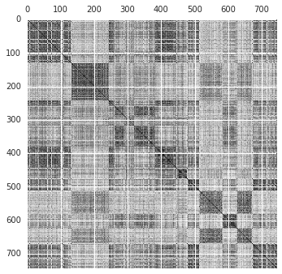
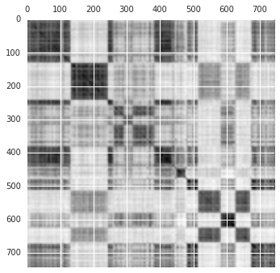
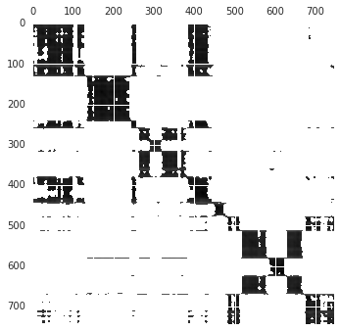
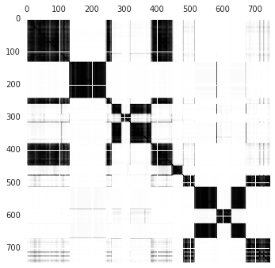
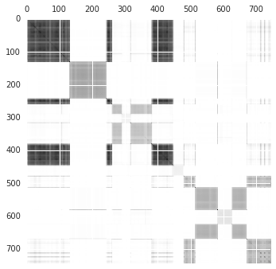
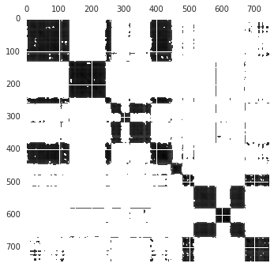
Spectral clustering: Refinement operations
Gaussian Blur
Thresholding
Symmetrization
Normalization
Diffusion

Slide 38
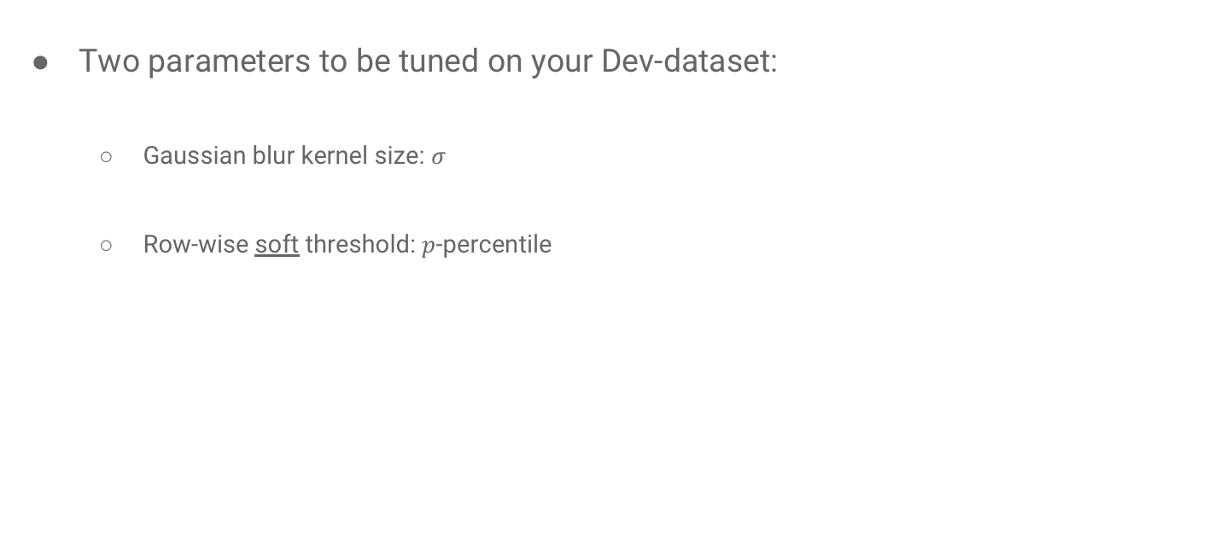
Spectral clustering: Parameters
Two parameters to be tuned on your Dev-dataset:
Gaussian blur kernel size: $σ$
Row-wise soft threshold: $p$-percentile
Hard thresholding:
Lots of zeros in the matrix
Soft thresholding:
Most numbers in matrix are still non-zero

Slide 39
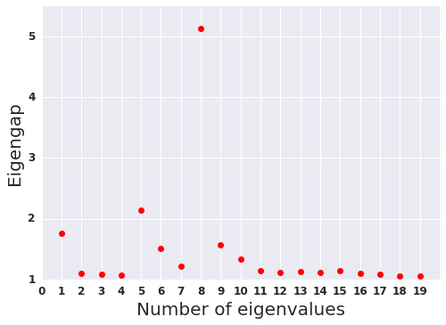
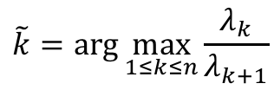
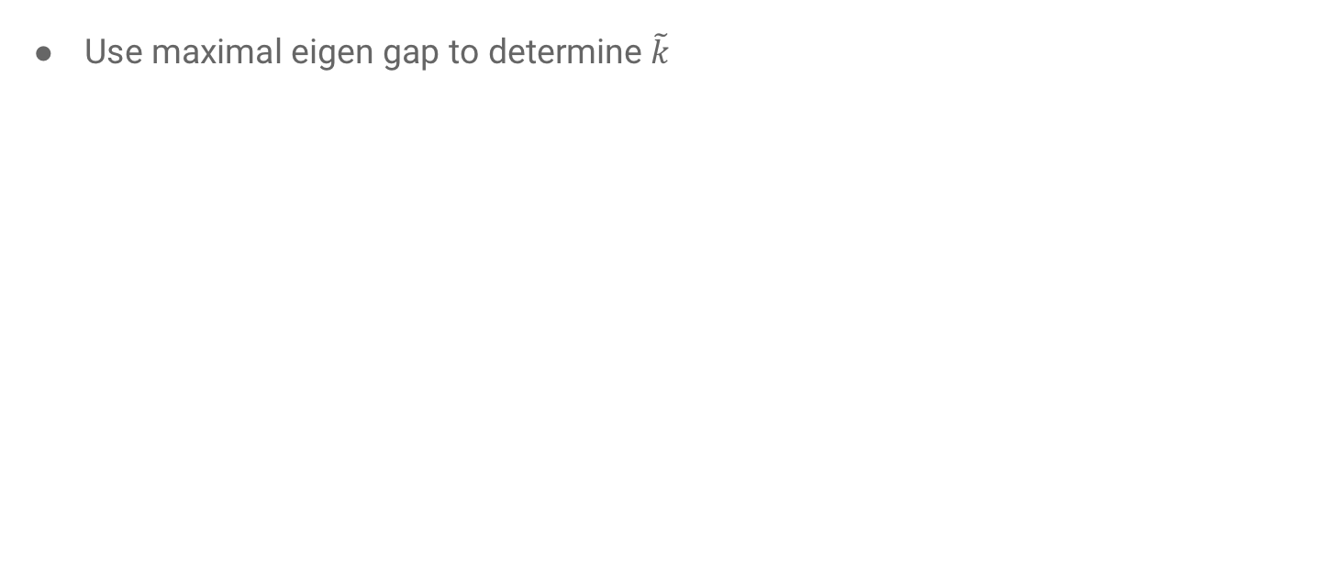
Spectral clustering: Number of clusters
Use maximal eigen gap to determine $\tilde{k}$
$$\tilde{k}=\arg{\max_{1≤k≤n}{\frac{λ_{k}}{λ_{k+1}}}}$$
8 clusters is optimal

Slide 40
Spectral clustering: Non-Gaussian data
Graph cut

Slide 41
Spectral clustering: Imbalanced clusters
Graph cut

Slide 42
Spectral clustering: Gender/Age/Race effects
Graph cut
Male
Female

Slide 43
Spectral clustering: Overlapping speech
Graph cut

Slide 44
Part 5:
Metrics and Datasets

Slide 45
Permutation invariance
Evaluation of diarization results must be permutation-invariant
Consider this example:
Ground truth: A, B, B, C, A
Hypothesis: C, A, A, B, C
They are actually equivalent
Solution:
Before computing errors, first find an optimal speaker mapping between truth and hypothesis
This is a standard assignment problem, and can be solved with Hungarian algorithm

Slide 46
Components of the error
Reference
(ground truth)
Hypothesis
(model output)

Slide 47
Components of the error
Reference
(ground truth)
Hypothesis
(model output)
Miss
False
Alarm
Overlap
Confusion
VAD, segmentation, etc.
Usually ignored in literature
In literature, people only report this

Slide 48
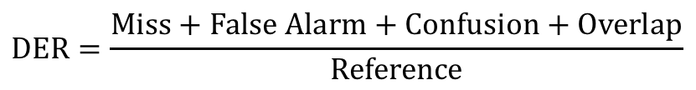
Diarization Error Rate (DER)
DER may be larger than 1.0, according to the NIST definition.
This is the strict form. In literature, most papers use confusion as DER.
We use pyannote.metrics library:
Modern library. Actively maintained. Quick bug fixes.
Great readability. Detailed documentation.
Good test coverage.
$$DER=\frac{Miss+False Alarm+Confusion+Overlap}{Reference}$$

Slide 49
Public datasets
2000 NIST Speaker Recognition Evaluation (SRE 2000), Disk 8
Used by most papers. Often referred to as “CALLHOME”.
500 short utterances, each containing 2~7 speakers, from 6 languages.
CALLHOME American English
Used by a few papers, especially the two-speaker only subset known as CH-109.
120 long utterances. American English only.
2003 NIST Rich Transcription (RT-03)
We use the telephone speech part to compare algorithms.

Slide 50
Conventions and common practices
Merge multi-channel audio to mono-channel
Exclude overlapped speech from evaluation
[RT-03] Evaluate only on segments determined by un-partitioned evaluation map (UEM) files
[SRE 2000 & CALLHOME] Tolerate boundary offset errors smaller than 250ms (known as the “collar” value)

Slide 51
Part 6:
Experiment Results

Slide 52
Model training
Training set:
(Anonymized) Voice searches, 36M utterances, 18K speakers
Completely out-of-domain data, compared with evaluation sets
Voice activity detector (VAD):
PLP features, two full-variance Gaussians, one for speech, one for non-speech
i-vector:
PLP features, GMM-UBM with 512 Gaussians, TV with 100 eigen-vectors, finally 50-dim projection
d-vector:
3-layer LSTM, each with 768 nodes and 256-dim projection, finally 256-dim linear

Slide 53
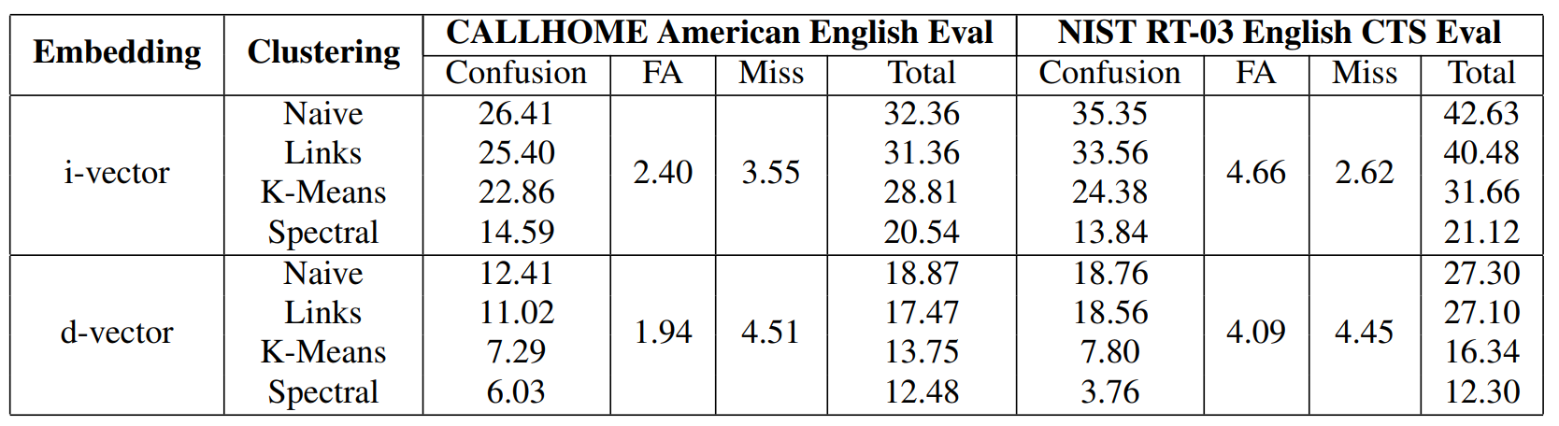
Evaluations: English-only datasets
Disclaimers:
i-vectors are actually NOT this bad. They just don’t scale well, and don’t generalize well when trained with out-of-domain data.
For each evaluation, we separate a Dev Set from Eval Set for parameter tuning.

Slide 54
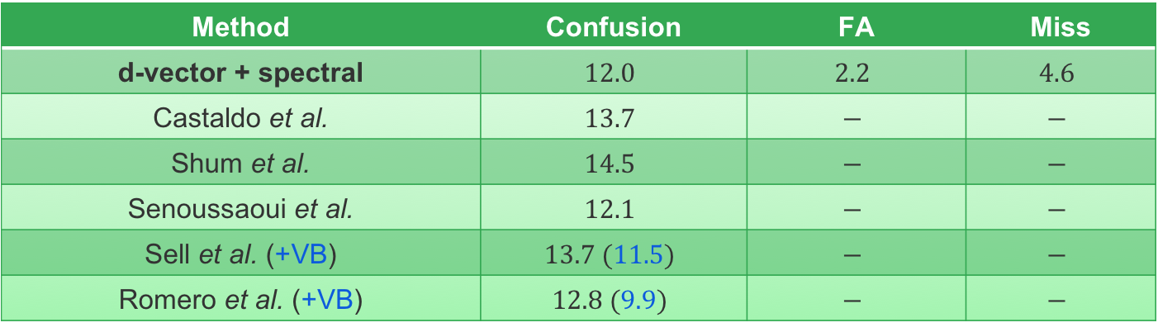
Evaluations: NIST SRE 2000 CALLHOME
Method | Confusion | FA | Miss
d-vector + spectral | $$12.0$$ | $$2.2$$ | $$4.6$$
Castaldo et al. | $$13.7$$ | $$−$$ | $$−$$
Shum et al. | $$14.5$$ | $$−$$ | $$−$$
Senoussaoui et al. | $$12.1$$ | $$−$$ | $$−$$
Sell et al. (+VB) | $$13.7 (11.5)$$ | $$−$$ | $$−$$
Romero et al. (+VB) | $$12.8 (9.9)$$ | $$−$$ | $$−$$
Comparisons are NOT apple-to-apple (an unfortunate fact in diarization community)
People use different VADs, usually non-public
People use different evaluation software
People use different datasets for training and parameter tuning
Some people perform Variational Bayesian resegmentation (the VB values)

Slide 55
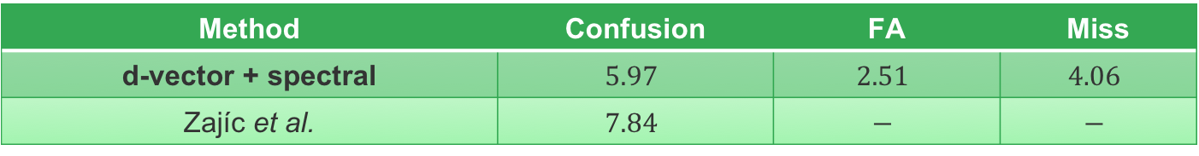
Evaluations: CH-109
Method | Confusion | FA | Miss
d-vector + spectral | $$5.97$$ | $$2.51$$ | $$4.06$$
Zajíc et al. | $$7.84$$ | $$−$$ | $$−$$
CH-109
This is the two-speaker subset of CALLHOME American English
The clustering algorithm is configured to fix the number of clusters to 2
* Zbyněk Zajíc, et al., “Speaker diarization using convolutional neural network for statistics accumulation refinement,” INTERSPEECH 2017.

Slide 56
Conclusions
We built an state-of-the-art speaker diarization system with:
Text-independent speaker verification model (d-vectors)
Trained with generalized end-to-end loss
3-layer LSTM, running on sliding windows
Spectral clustering
Using eigen-gap to find number of clusters
A sequence of refinement operations on affinity matrix

Slide 57
Part 7:
Future Work

Slide 58
The holy grail: End-to-end diarization
One neural network model to replace all:
Speaker embedding extraction
Segmentation
Clustering
Other components: VAD, resegmentation, etc.
A loss function directly based on Diarization Error Rate (DER):
Permutation-invariant loss

Slide 59
Acknowledgements
Dr. Hervé Bredin (CNRS)
Continuous support with the pyannote.metrics library
Dr. Gregory Sell (JHU) and Prof. Pietro Laface (polito.it)
Sharing NIST SRE 2000 ground truth labels with us
Helping us understand the evaluation datasets and protocols
Yash Sheth and Richard Rose (Google)
Helpful discussions

Slide 60
Questions?

